Slide 1
Pronunciation Tool
Design Approach
Shankhnaad Team

Slide 2
Technology Stack
Azure Cloud
Azure Cloud Text-to-Speech API
Web Development Framework(Django)
UI Framework(Bootstrap)
Programming Language(Python)
Rest API Framework(Django)
Database (PostgreSql)

Slide 3

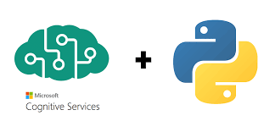

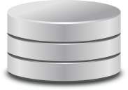
Reference Architecture
User
Collect data
Request
Display Result
Response
Contain App Logic
(Pyhton Django REST Framework)
UI Design
(Django with Bootstrap, Ajax)
Front End
Web Application Server(Django)
Blob Storage
PostgreSql

Slide 4
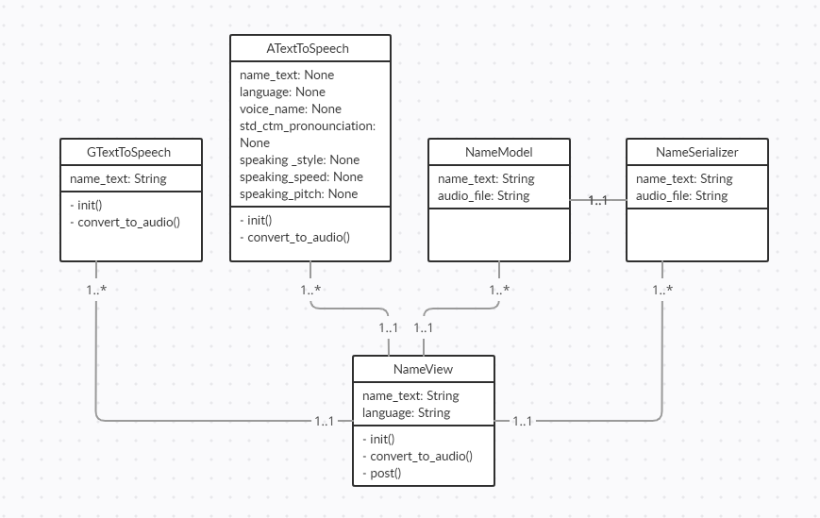
REST Service Class Diagram

Slide 5
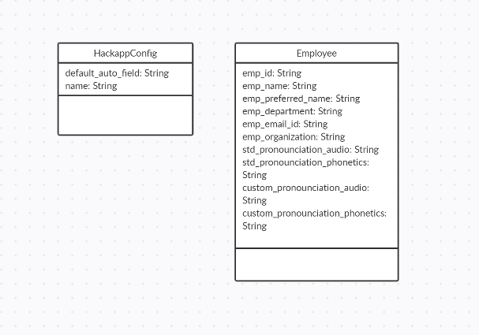
UI Class Diagram

Slide 6
Application Demo

Slide 7
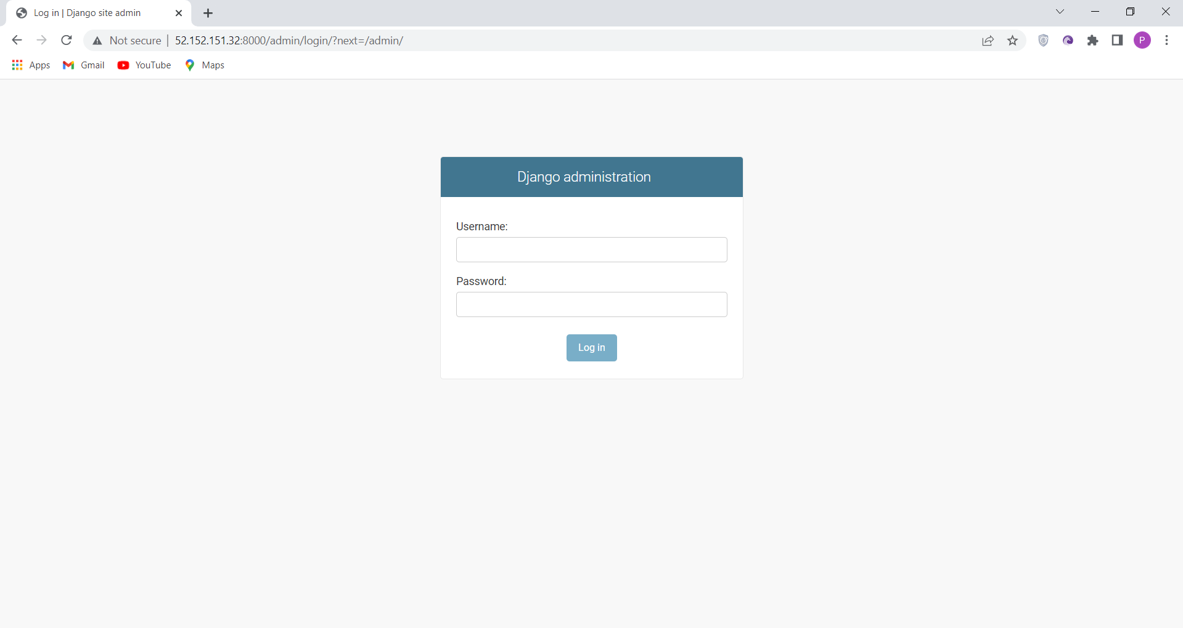
Admin Login Page

Slide 8
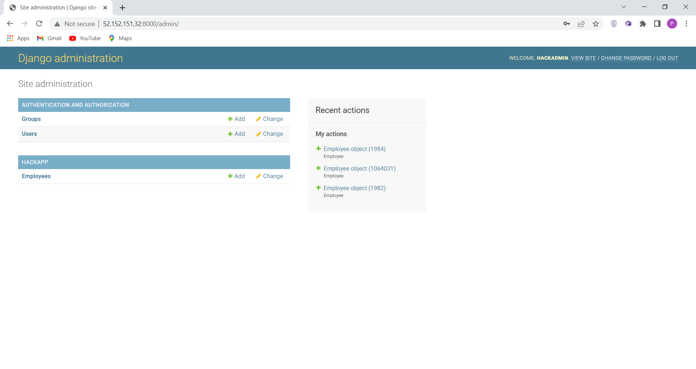
Admin Landing/Dashboard Page

Slide 9
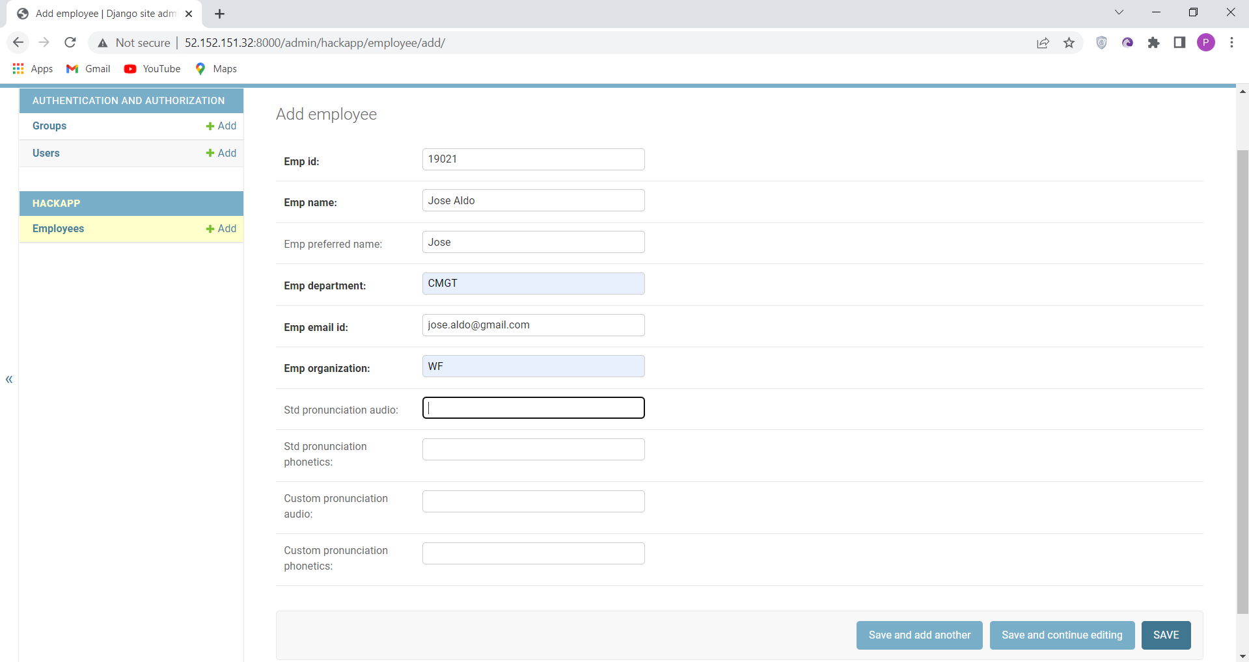
Employee Creation Page

Slide 10
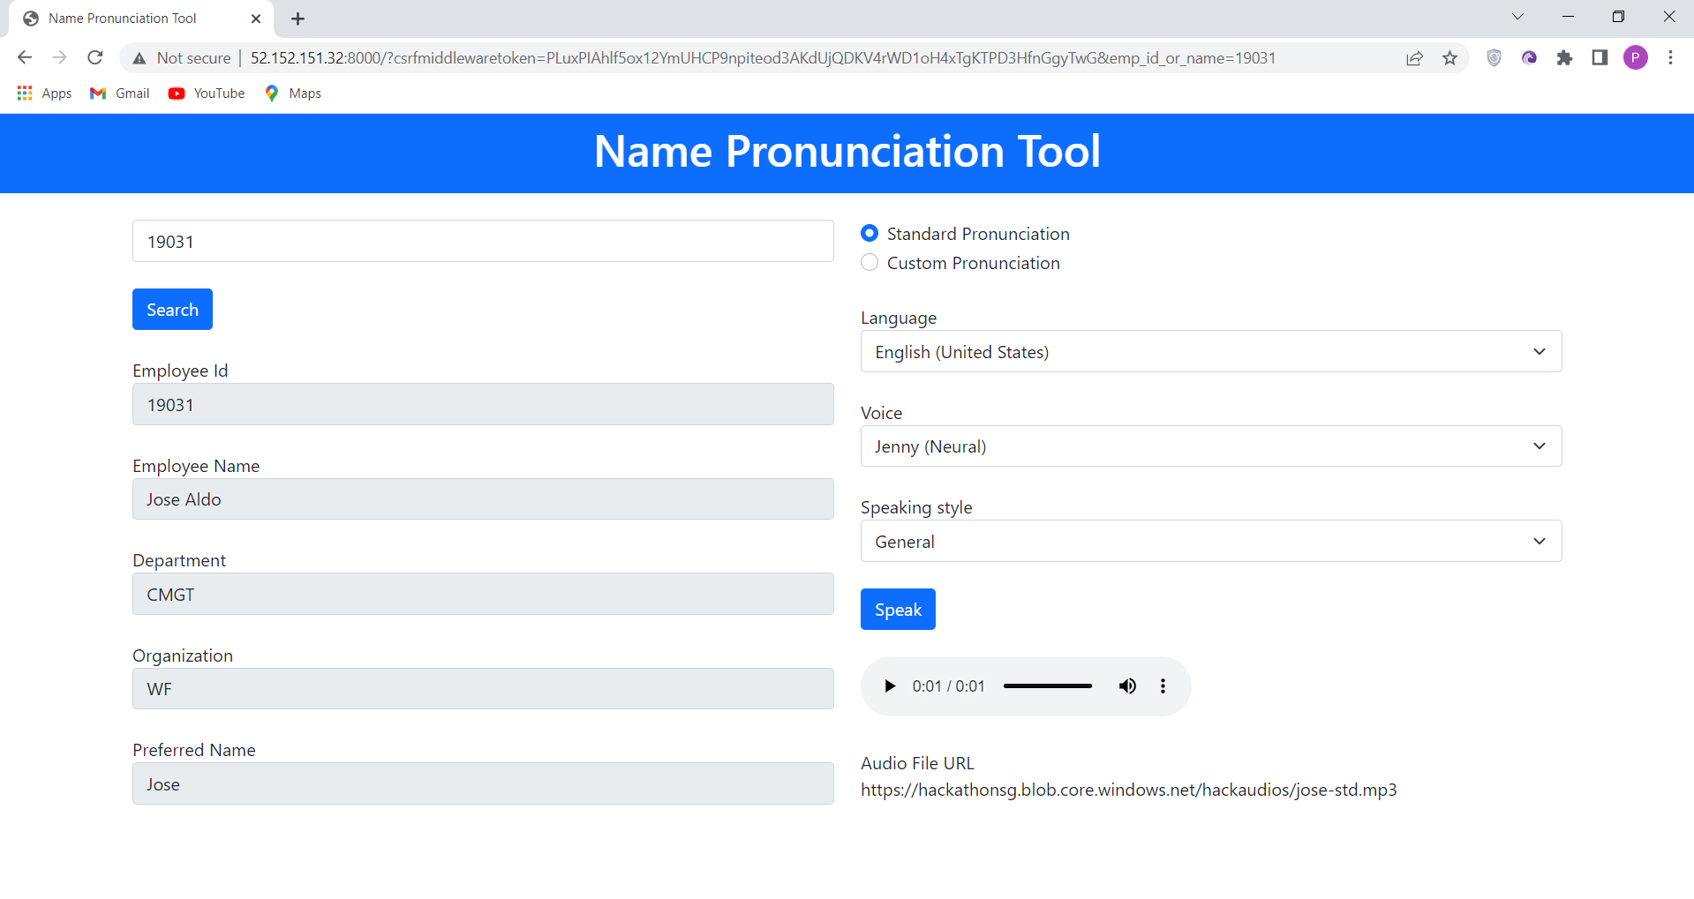
Application Landing Page – Standard Pronunciation

Slide 11
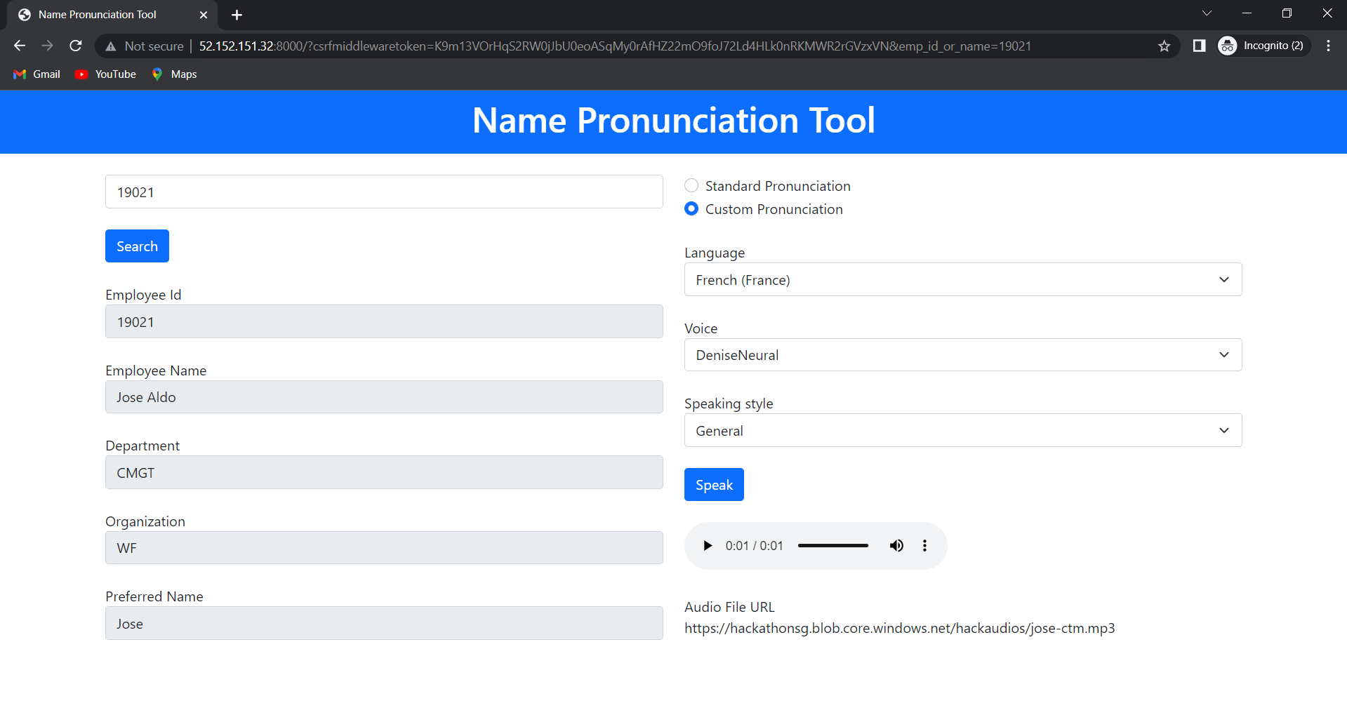
Application Landing Page – Custom Pronunciation

Slide 12
Thank You

